Slide 1
Bangladesh Economy Problems & Solutions
Presented by:
Afsana Kabir Sinthia
182002068

Slide 2





Snapshot
Present Status of Bangladesh Economy
Comparison of growth with World and Asian Countries
Future Prospects of Bangladesh
Challenges of Bangladesh
Possible Solutions

Slide 3
Status of Bangladesh Economy
Economy cycle
Bangladesh Economy Data
 | 2015 | 2016 | 2017 | 2018 | 2019
Population (million) | 160 | 162 | 163 | 165 | 167
GDP per capita (USD) | 1,220 | 1,372 | 1,521 | 1,650 | 1,829
GDP (USD bn) | 195 | 222 | 248 | 272 | 305
Economic Growth (GDP, annual variation in %) | 6.6 | 7.1 | 7.3 | 7.9 | 8.2
Industrial Production (annual variation in %) | 11.8 | 13.1 | 14.6 | 14.8 | 8.6
Fiscal Balance (% of GDP) | -4.0 | -3.4 | -3.3 | -4.6 | -5.2
Public Debt (% of GDP) | 33.7 | 33.3 | 33.4 | 34.6 | 35.7
Money (annual variation in %) | 12.4 | 16.4 | 10.9 | 9.2 | 9.9
Inflation Rate (CPI, annual variation in %, eop) | 6.1 | 5.0 | 5.8 | 5.3 | 5.7
Inflation Rate (CPI, annual variation in %) | 6.2 | 5.5 | 5.7 | 5.5 | 5.6
Exchange Rate (vs USD) | - | - | - | - | -
Exchange Rate (vs USD, aop) | - | - | - | - | -
Current Account (% of GDP) | 1.8 | 1.9 | -0.5 | -3.5 | -1.7
Current Account Balance (USD bn) | 3.5 | 4.3 | -1.3 | -9.6 | -5.3
Trade Balance (USD billion) | -5.9 | -5.4 | -9.5 | -18.2 | -15.4
Exports (USD billion) | 30.7 | 33.5 | 34.0 | 36.3 | 40.0
Imports (USD billion) | 36.6 | 38.8 | 43.5 | 54.5 | 55.4
Exports (annual variation in %) | 3.3 | 9.0 | 1.7 | 6.6 | 10.2
Imports (annual variation in %) | -0.7 | 6.0 | 12.0 | 25.2 | 1.8
International Reserves (USD) | 27.5 | 32.1 | 33.2 | 32.0 | 32.7
External Debt (% of GDP) | 18.6 | 17.5 | 19.0 | 19.2 | -
Bangladesh Economy

Slide 4
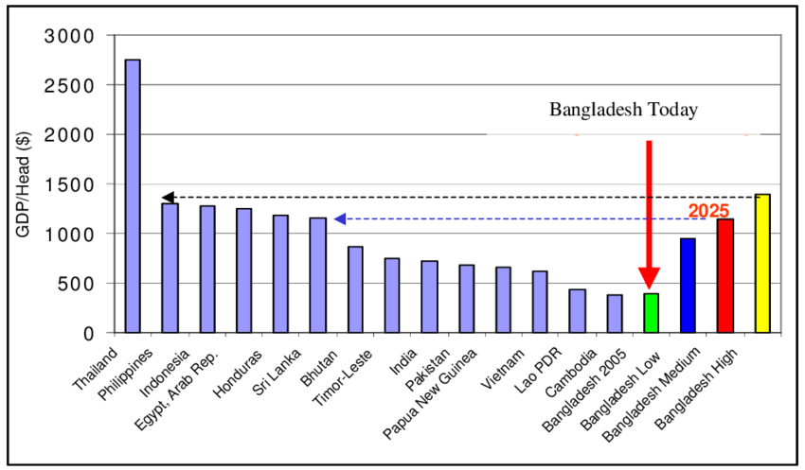
Comparison of growth with World and Asian Countries

Slide 5
Future Prospects of Bangladesh
Bangladesh has made remarkable progress in reducing poverty, supported by sustained economic growth.
Life expectancy, literacy rates and per capita food production have increased significantly. Progress has been underpinned by steady growth in GDP. Bangladesh reached the lower middle-income country status in 2015.
. In 2018, Bangladesh fulfilled all three eligibility criteria for graduation from the UN’s Least Developed Countries (LDC) list for the first time and is on track for graduation in 2024.

Slide 6
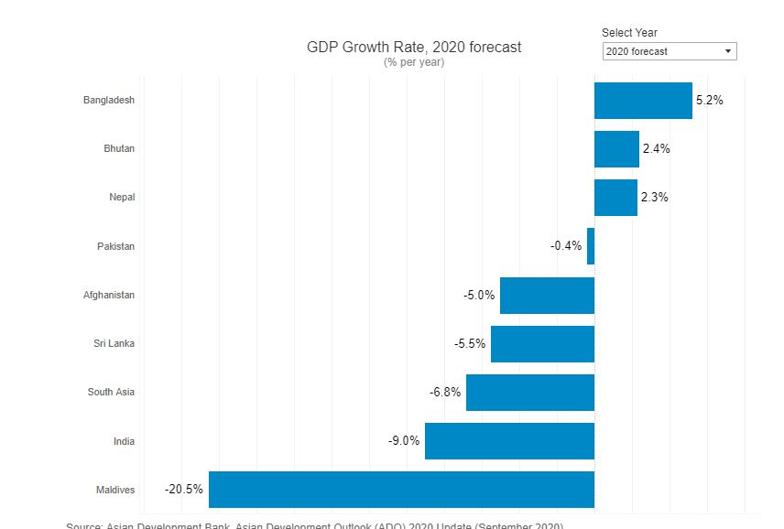
Future Prospects of Bangladesh

Slide 7
Challenges of Bangladesh
Lack of Infrastructural facilities
Lack of deep sea port
Lack of easy communication system
Attracting handsome amount of FDI
Ensuring Political stability
Becoming a Upper Middle Income Country by 2030
Enhancing share of export
Effective utilization of foreign aids
Maintaining lower inflation rate
Balancing between Govt. revenue and expenditure
Taking effective strategies to diversify export
Minimizing corruption
Poverty Reduction
The COVID-19 pandemic will deepen the challenges including a decline in exports, lower private investment, and job losses. Investment and exports are likely to continue to suffer amid uncertainty about the recovery of global demand. The poor and vulnerable are more impacted with income loss and poverty may rise. The implementation of the government’s COVID-19 response program will remain a paramount priority.

Slide 8
Possible Solutions
Creating more and better jobs for its youth remains a critical priority for Bangladesh to turn around and achieve its development vision. To do so, Bangladesh will need to remove the barriers to higher investment posed by low access to reliable and affordable power, poor transportation infrastructure, limited availability of serviced land, uncertain and complex business regulation, among others. Challenges related to COVID-19, rapid urbanization and climate change need to be addressed through long-term planning.

Slide 9
With the right policies and timely action, Bangladesh can accelerate its recovery from the economic downturn and continue to progress towards upper-middle income status

Slide 10
THANK YOU

